Slide 1
Covid Bed slot Booking system
Rooshil Bhatia PA1

Slide 2
Domain of the Project
Database Management
Web Deveploment
Staticstical Analysis

Slide 3
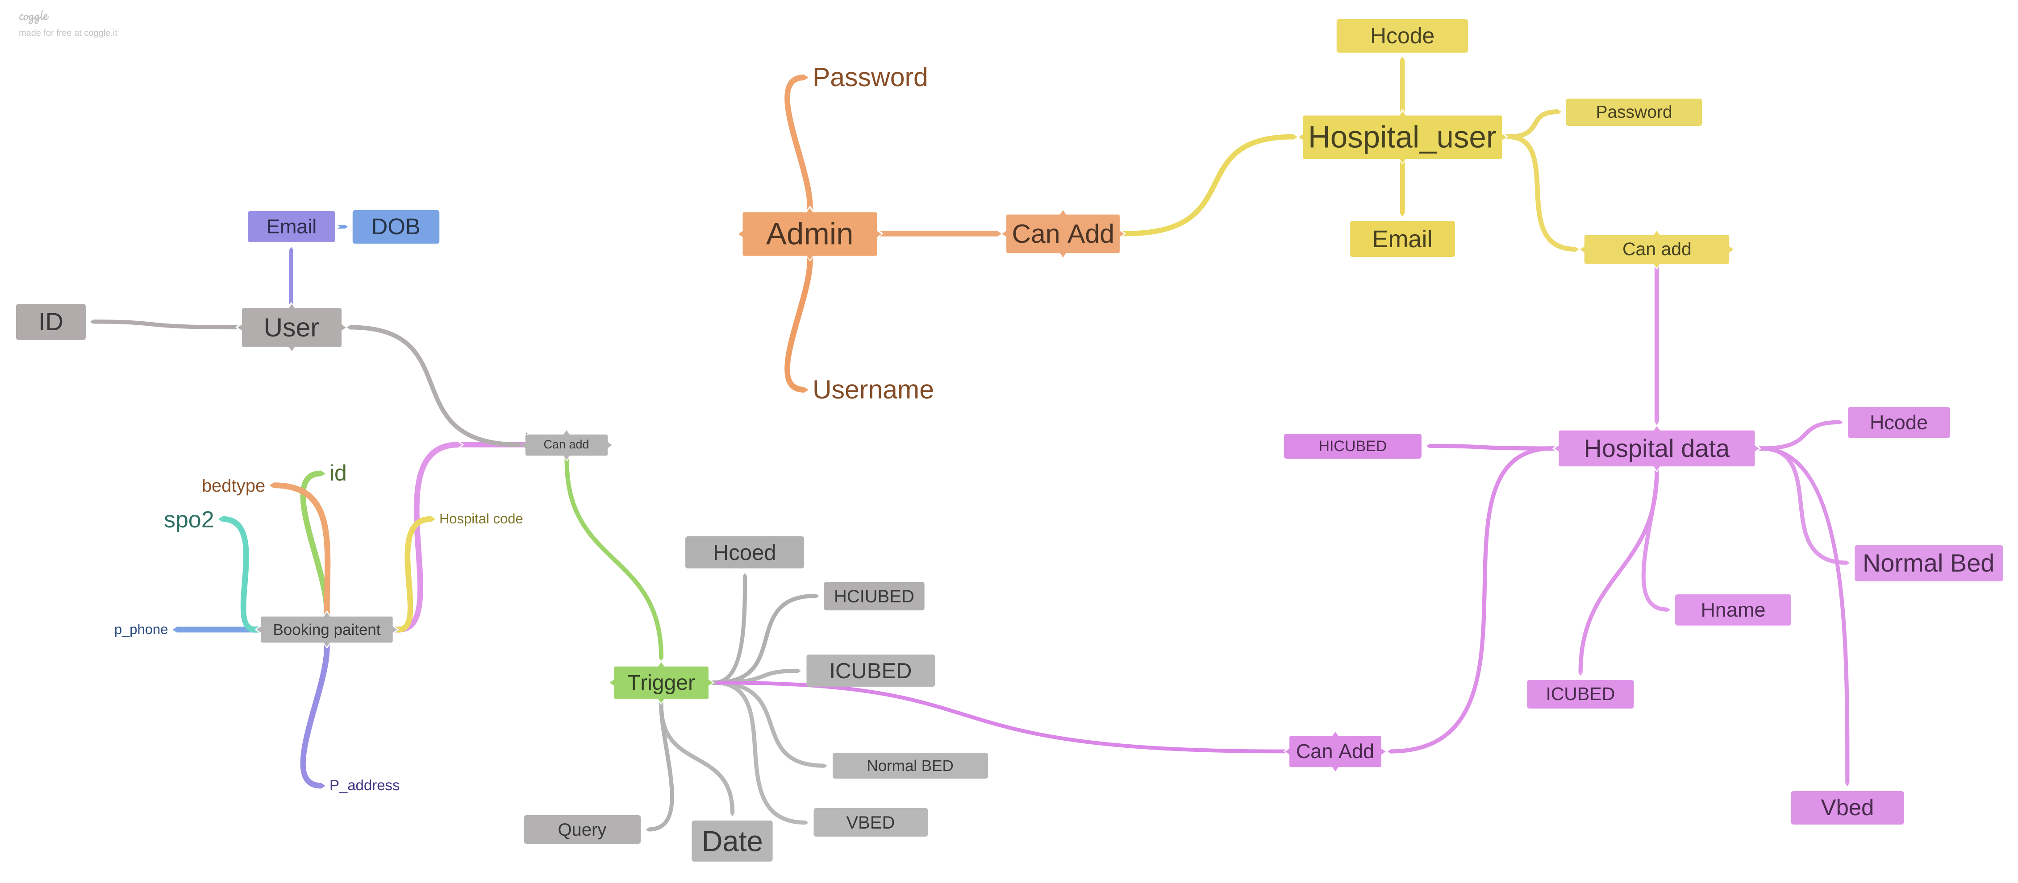
Idea/Diagram for Workflow Used coggle to create it.

Slide 4
Introduction:
As in the peak pandemic time there was a chaos to book a bed for Covid-19 patients and Delhi Government initiated the need for a platform so that people can book their own hospital beds if needed in emergency. This motivated us to uplift and add some more features that may come in hand to keep track and store data of the covid 19 patients and have created some admin roles to manage the website it is also flexible in terms of adding a new hospital or removing one with real time updates and using triggers and commit methods to store data entered by the customer. As SQL is both DML(Data Manipulation Language) and DDL(Data Definition Language) we used the DDL component of SQL to create multiple databases which will include database for hospital details, database for admin details, database for patients information and database to store all the commit and trigger operations.

Slide 5
Software Requirements:
Software requirements:
1. VS code editor
2. Python ide
3. Xampp server

Slide 6
Aim
Building a webapp to help the society to keep track of all the medical services available in their city.
To prevent concurrent booking of a single bed by row locking technique in dbms.
Wrote queries in sql to reflect real time changes in the database directly on the web app.
A separate database for admitted and discharged patients which can help in determining the recovery rate.

Slide 7
Aim 2.0
All the Login Pages Design(week1)
Building Templates for the login pages(week 2)
Integrating data set Updates inside Available beds.(week3)
Getting a email service(week 3)
Analysis on the present data set given in the Read more(week3)
Testing all the Triggers and functionality of the Webapp(week 7)
Integrating a payment gateway(week8)

Slide 8
References
Bootstrapmade.com
W3schools
Tutorials Point

Slide 9
Thank You
Rooshil Bhatia

